Slide 1
Wireless & Mobile Communications
Chapter 5: Wireless LANs
Characteristics
IEEE 802.11
  PHY
  MAC
  Roaming
Bluetooth

Slide 2
Characteristics of wireless LANs
Advantages
  very flexible within the reception area
  Ad-hoc networks without previous planning possible
  (almost) no wiring difficulties (e.g. historic buildings, firewalls)
  more robust against disasters like, e.g., earthquakes, fire - or users pulling a plug...
Disadvantages
  typically very low bandwidth compared to wired networks
  (1-10 Mbit/s)
  many proprietary solutions, especially for higher bit-rates, standards take their time (e.g. IEEE 802.11)
  products have to follow many national restrictions if working wireless, it takes a vary long time to establish global solutions like, e.g., IMT-2000
ICS 243E - Ch 5 Wireless Lans
Winter 2001
5.<number>

Slide 3
Design goals for wireless LANs
  global, seamless operation
  low power for battery use
  no special permissions or licenses needed to use the LAN
  robust transmission technology
  simplified spontaneous cooperation at meetings
  easy to use for everyone, simple management
  protection of investment in wired networks
  security (no one should be able to read my data), privacy (no one should be able to collect user profiles), safety (low radiation)
  transparency concerning applications and higher layer protocols, but also location awareness if necessary
ICS 243E - Ch 5 Wireless Lans
Winter 2001
5.<number>

Slide 4
Comparison: infrared vs. radio transmission
Infrared
  uses IR diodes, diffuse light, multiple reflections (walls, furniture etc.)
Advantages
  simple, cheap, available in many mobile devices
  no licenses needed
  simple shielding possible
Disadvantages
  interference by sunlight, heat sources etc.
  many things shield or absorb IR light
  low bandwidth
Example
  IrDA (Infrared Data Association) interface available everywhere
Radio
  typically using the license free ISM band at 2.4 GHz
Advantages
  experience from wireless WAN and mobile phones can be used
  coverage of larger areas possible (radio can penetrate walls, furniture etc.)
Disadvantages
  very limited license free frequency bands
  shielding more difficult, interference with other electrical devices
Example
  WaveLAN, HIPERLAN, Bluetooth
ICS 243E - Ch 5 Wireless Lans
Winter 2001
5.<number>

Slide 5

Comparison: infrastructure vs. ad-hoc networks
infrastructure
network
AP: Access Point
AP
AP
wired network
AP
ad-hoc network
ICS 243E - Ch 5 Wireless Lans
Winter 2001
5.<number>

Slide 6
802.11 - Architecture of an infrastructure network
Station (STA)
  terminal with access mechanisms to the wireless medium and radio contact to the access point
Basic Service Set (BSS)
  group of stations using the same radio frequency
Access Point
  station integrated into the wireless LAN and the distribution system
Portal
  bridge to other (wired) networks
Distribution System
  interconnection network to form one logical network (EES: Extended Service Set) based
  on several BSS
802.11 LAN
802.x LAN
STA₁
BSS₁
Access
Point
Portal
Distribution System
ESS
Access
Point
BSS₂
STA₂
802.11 LAN
STA₃
ICS 243E - Ch 5 Wireless Lans
Winter 2001
5.<number>
Notes:
Universität Karlsruhe
Institut für Telematik
Mobilkommunikation
SS 1998
Prof. Dr. Dr. h.c. G. Krüger
E. Dorner / Dr. J. Schiller
9

Slide 7
802.11 - Architecture of an ad-hoc network
Direct communication within a limited range
  Station (STA):
  terminal with access mechanisms to the wireless medium
  Basic Service Set (BSS):
  group of stations using the same radio frequency
802.11 LAN
STA₁
BSS₁
STA₃
STA₂
BSS₂
STA₅
STA₄
802.11 LAN
ICS 243E - Ch 5 Wireless Lans
Winter 2001
5.<number>

Slide 8
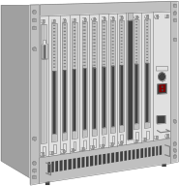


IEEE standard 802.11
fixed terminal
mobile terminal
server
infrastructure network
access point
application
application
TCP
TCP
IP
IP
LLC
LLC
LLC
802.11 MAC
802.11 MAC
802.3 MAC
802.3 MAC
802.11 PHY
802.11 PHY
802.3 PHY
802.3 PHY
ICS 243E - Ch 5 Wireless Lans
Winter 2001
5.<number>

Slide 9
802.11 - Layers and functions
MAC
  access mechanisms, fragmentation, encryption
MAC Management
  synchronization, roaming, MIB, power management
PLCP Physical Layer Convergence Protocol
  clear channel assessment signal (carrier sense)
PMD Physical Medium Dependent
  modulation, coding
PHY Management
  channel selection, MIB
Station Management
  coordination of all management functions
Station Management
LLC
DLC
MAC
MAC Management
PLCP
PHY Management
PHY
PMD
ICS 243E - Ch 5 Wireless Lans
Winter 2001
5.<number>

Slide 10
802.11 - Physical layer
3 versions: 2 radio (typ. 2.4 GHz), 1 IR
  data rates 1 or 2 Mbit/s
FHSS (Frequency Hopping Spread Spectrum)
  spreading, despreading, signal strength, typ. 1 Mbit/s
  min. 2.5 frequency hops/s (USA), two-level GFSK modulation
DSSS (Direct Sequence Spread Spectrum)
  DBPSK modulation for 1 Mbit/s (Differential Binary Phase Shift Keying), DQPSK for 2 Mbit/s (Differential Quadrature PSK)
  preamble and header of a frame is always transmitted with 1 Mbit/s, rest of transmission 1 or 2 Mbit/s
  chipping sequence: +1, -1, +1, +1, -1, +1, +1, +1, -1, -1, -1 (Barker code)
  max. radiated power 1 W (USA), 100 mW (EU), min. 1mW
Infrared
  850-950 nm, diffuse light, typ. 10 m range
  carrier detection, energy detection, synchonization
ICS 243E - Ch 5 Wireless Lans
Winter 2001
5.<number>

Slide 11
FHSS PHY packet format
Synchronization
  synch with 010101... pattern
SFD (Start Frame Delimiter)
  0000110010111101 start pattern
PLW (PLCP_PDU Length Word)
  length of payload incl. 32 bit CRC of payload, PLW < 4096
PSF (PLCP Signaling Field)
  data of payload (1 or 2 Mbit/s)
HEC (Header Error Check)
  CRC with x¹⁶+x¹²+x⁵+1
80
16
12
4
16
variable
bits
synchronization
SFD
PLW
PSF
HEC
payload
PLCP preamble
PLCP header
ICS 243E - Ch 5 Wireless Lans
Winter 2001
5.<number>

Slide 12
DSSS PHY packet format
Synchronization
  synch., gain setting, energy detection, frequency offset compensation
SFD (Start Frame Delimiter)
  1111001110100000
Signal
  data rate of the payload (0A: 1 Mbit/s DBPSK; 14: 2 Mbit/s DQPSK)
Service Length
  future use, 00: 802.11 compliant  length of the payload
HEC (Header Error Check)
  protection of signal, service and length, x¹⁶+x¹²+x⁵+1
128
16
8
8
16
16
variable
bits
synchronization
SFD
signal
service
length
HEC
payload
PLCP preamble
PLCP header
ICS 243E - Ch 5 Wireless Lans
Winter 2001
5.<number>

Slide 13

802.11 - MAC layer I - DFWMAC
Traffic services
  Asynchronous Data Service (mandatory)
    exchange of data packets based on “best-effort”
    support of broadcast and multicast
  Time-Bounded Service (optional)
    implemented using PCF (Point Coordination Function)
Access methods
  DFWMAC-DCF CSMA/CA (mandatory)
    collision avoidance via randomized „back-off“ mechanism
    minimum distance between consecutive packets
    ACK packet for acknowledgements (not for broadcasts)
  DFWMAC-DCF w/ RTS/CTS (optional)
    Distributed Foundation Wireless MAC
    avoids hidden terminal problem
  DFWMAC- PCF (optional)
    access point polls terminals according to a list
ICS 243E - Ch 5 Wireless Lans
Winter 2001
5.<number>

Slide 14
802.11 - MAC layer II
Priorities
  defined through different inter frame spaces
  no guaranteed, hard priorities
  SIFS (Short Inter Frame Spacing)
    highest priority, for ACK, CTS, polling response
  PIFS (PCF IFS)
    medium priority, for time-bounded service using PCF
  DIFS (DCF, Distributed Coordination Function IFS)
    lowest priority, for asynchronous data service
DIFS
DIFS
PIFS
medium busy
SIFS
contention
next frame
t
direct access if
medium is free ≥ DIFS
ICS 243E - Ch 5 Wireless Lans
Winter 2001
5.<number>

Slide 15
802.11 - CSMA/CA access method I
contention window
(randomized back-off
mechanism)
DIFS
DIFS
medium busy
next frame
direct access if
medium is free ≥ DIFS
t
slot time
  station ready to send starts sensing the medium (Carrier Sense based on CCA, Clear Channel Assessment)
  if the medium is free for the duration of an Inter-Frame Space (IFS), the station can start sending (IFS depends on service type)
  if the medium is busy, the station has to wait for a free IFS, then the station must additionally wait a random back-off time (collision avoidance, multiple of slot-time)
  if another station occupies the medium during the back-off time of the station, the back-off timer stops (fairness)
ICS 243E - Ch 5 Wireless Lans
Winter 2001
5.<number>
Notes:
Universität Karlsruhe
Institut für Telematik
Mobilkommunikation
SS 1998
Prof. Dr. Dr. h.c. G. Krüger
E. Dorner / Dr. J. Schiller
12

Slide 16
802.11 - competing stations - simple version
DIFS
DIFS
DIFS
DIFS
bo_{e}
bo_{r}
bo_{e}
bo_{r}
bo_{e}
busy
station₁
bo_{e}
busy
station₂
busy
station₃
bo_{e}
busy
bo_{e}
bo_{r}
station₄
bo_{e}
bo_{r}
bo_{e}
busy
bo_{e}
bo_{r}
station₅
t
busy
medium not idle (frame, ack etc.)
bo_{e}
elapsed backoff time
packet arrival at MAC
bo_{r}
residual backoff time
ICS 243E - Ch 5 Wireless Lans
Winter 2001
5.<number>

Slide 17
802.11 - CSMA/CA access method II
Sending unicast packets
  station has to wait for DIFS before sending data
  receivers acknowledge at once (after waiting for SIFS) if the packet was received correctly (CRC)
  automatic retransmission of data packets in case of transmission errors
DIFS
data
sender
SIFS
ACK
receiver
DIFS
other
stations
data
t
waiting time
contention
ICS 243E - Ch 5 Wireless Lans
Winter 2001
5.<number>

Slide 18
802.11 - DFWMAC
Sending unicast packets
  station can send RTS with reservation parameter after waiting for DIFS (reservation determines amount of time the data packet needs the medium)
  acknowledgement via CTS after SIFS by receiver (if ready to receive)
  sender can now send data at once, acknowledgement via ACK
  other stations store medium reservations distributed via RTS and CTS
DIFS
RTS
data
sender
SIFS
SIFS
SIFS
CTS
ACK
receiver
NAV (RTS)
DIFS
other
stations
data
NAV (CTS)
t
defer access
contention
ICS 243E - Ch 5 Wireless Lans
Winter 2001
5.<number>

Slide 19
Fragmentation
DIFS
RTS
frag₁
frag₂
sender
SIFS
SIFS
SIFS
SIFS
SIFS
CTS
ACK₁
ACK₂
receiver
NAV (RTS)
NAV (CTS)
NAV (frag₁)
DIFS
other
stations
data
NAV (ACK₁)
t
contention
ICS 243E - Ch 5 Wireless Lans
Winter 2001
5.<number>

Slide 20
DFWMAC-PCF I
t₀
t₁
SuperFrame
medium busy
PIFS
SIFS
SIFS
D₁
D₂
point
coordinator
SIFS
SIFS
U₁
U₂
wireless
stations
stations‘
NAV
NAV
ICS 243E - Ch 5 Wireless Lans
Winter 2001
5.<number>

Slide 21
DFWMAC-PCF II
t₂
t₃
t₄
PIFS
SIFS
D₃
D₄
CF_{end}
point
coordinator
SIFS
U₄
wireless
stations
stations‘
NAV
NAV
contention free period
contention
period
t
ICS 243E - Ch 5 Wireless Lans
Winter 2001
5.<number>

Slide 22
802.11 - Frame format
Types
  control frames, management frames, data frames
Sequence numbers
  important against duplicated frames due to lost ACKs
Addresses
  receiver, transmitter (physical), BSS identifier, sender (logical)
Miscellaneous
  sending time, checksum, frame control, data
bytes
2
2
6
6
6
2
6
0-2312
4
Frame
Control
Duration
ID
Address
1
Address
2
Address
3
Sequence
Control
Address
4
Data
CRC
version, type, fragmentation, security, ...
ICS 243E - Ch 5 Wireless Lans
Winter 2001
5.<number>

Slide 23
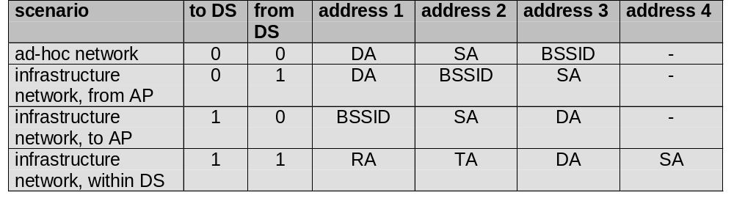
MAC address format
DS: Distribution System
AP: Access Point
DA: Destination Address
SA: Source Address
BSSID: Basic Service Set Identifier
RA: Receiver Address
TA: Transmitter Address
ICS 243E - Ch 5 Wireless Lans
Winter 2001
5.<number>

Slide 24
802.11 - MAC management
Synchronization
  try to find a LAN, try to stay within a LAN
  timer etc.
Power management
  sleep-mode without missing a message
  periodic sleep, frame buffering, traffic measurements
Association/Reassociation
  integration into a LAN
  roaming, i.e. change networks by changing access points
  scanning, i.e. active search for a network
MIB - Management Information Base
  managing, read, write
ICS 243E - Ch 5 Wireless Lans
Winter 2001
5.<number>

Slide 25
Synchronization using a Beacon (infrastructure)
beacon interval
B
B
B
B
access
point
busy
busy
busy
busy
medium
t
value of the timestamp
B
beacon frame
ICS 243E - Ch 5 Wireless Lans
Winter 2001
5.<number>

Slide 26
Synchronization using a Beacon (ad-hoc)
beacon interval
B₁
B₁
station₁
B₂
B₂
station₂
busy
busy
busy
busy
medium
t
value of the timestamp
B
beacon frame
random delay
ICS 243E - Ch 5 Wireless Lans
Winter 2001
5.<number>

Slide 27
Power management
Idea: switch the transceiver off if not needed
States of a station: sleep and awake
Timing Synchronization Function (TSF)
  stations wake up at the same time
Infrastructure
  Traffic Indication Map (TIM)
    list of unicast receivers transmitted by AP
  Delivery Traffic Indication Map (DTIM)
    list of broadcast/multicast receivers transmitted by AP
Ad-hoc
  Ad-hoc Traffic Indication Map (ATIM)
    announcement of receivers by stations buffering frames
    more complicated - no central AP
    collision of ATIMs possible (scalability?)
ICS 243E - Ch 5 Wireless Lans
Winter 2001
5.<number>

Slide 28
Power saving with wake-up patterns (infrastructure)
TIM interval
DTIM interval
D
B
T
T
d
D
B
access
point
busy
busy
busy
busy
medium
p
d
station
t
T
TIM
D
DTIM
awake
B
p
d
data transmission
to/from the station
broadcast/multicast
PS poll
ICS 243E - Ch 5 Wireless Lans
Winter 2001
5.<number>

Slide 29
Power saving with wake-up patterns (ad-hoc)
ATIM
window
beacon interval
B₁
A
D
B₁
station₁
B₂
B₂
a
d
station₂
t
B
beacon frame
random delay
A
transmit ATIM
D
transmit data
awake
a
acknowledge ATIM
d
acknowledge data
ICS 243E - Ch 5 Wireless Lans
Winter 2001
5.<number>

Slide 30
802.11 - Roaming
No or bad connection? Then perform:
Scanning
  scan the environment, i.e., listen into the medium for beacon signals or send probes into the medium and wait for an answer
Reassociation Request
  station sends a request to one or several AP(s)
Reassociation Response
  success: AP has answered, station can now participate
  failure: continue scanning
AP accepts Reassociation Request
  signal the new station to the distribution system
  the distribution system updates its data base (i.e., location information)
  typically, the distribution system now informs the old AP so it can release resources
ICS 243E - Ch 5 Wireless Lans
Winter 2001
5.<number>

Slide 31
Future developments
IEEE 802.11a
  compatible MAC, but now 5 GHz band
  transmission rates up to 20 Mbit/s
  close cooperation with BRAN (ETSI Broadband Radio Access Network)
IEEE 802.11b
  higher data rates at 2.4 GHz
  proprietary solutions already offer 10 Mbit/s
IEEE WPAN (Wireless Personal Area Networks)
  market potential
  compatibility
  low cost/power, small form factor
  technical/economic feasibility
  ➔ Bluetooth
ICS 243E - Ch 5 Wireless Lans
Winter 2001
5.<number>

Slide 32

Bluetooth
ICS 243E - Ch 5 Wireless Lans
Winter 2001
5.<number>

Slide 33

History
ICS 243E - Ch 5 Wireless Lans
Winter 2001
5.<number>

Slide 34









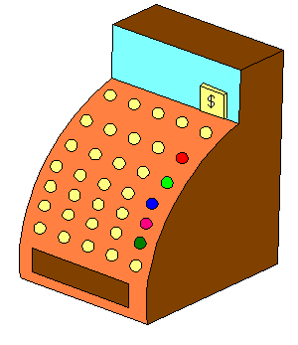


Usage Modes
Personal Ad-hoc Networks
Cable Replacement
Data/Voice Access Points
ICS 243E - Ch 5 Wireless Lans
Winter 2001
5.<number>

Slide 35


Bluetooth
Consortium: Ericsson, Intel, IBM, Nokia, Toshiba - many members
Scenarios
  connection of peripheral devices
    loudspeaker, joystick, headset
  support of ad-hoc networking
    small devices, low-cost
  bridging of networks
    e.g., GSM via mobile phone - Bluetooth - laptop
Simple, cheap, replacement of IrDA, low range, lower data rates
  2.4 GHz, FHSS (CDMA), TDD
ICS 243E - Ch 5 Wireless Lans
Winter 2001
5.<number>

Slide 36
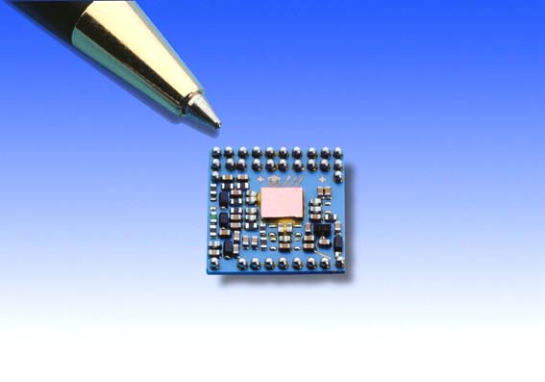
Technology Characteristics
Low-cost,
Low-power,
Small-sized,
Short-range,
Robust wireless technology
ICS 243E - Ch 5 Wireless Lans
Winter 2001
5.<number>

Slide 37
General Characteristics
Universal wireless interface
Ad-hoc networking architecture
80 Mhz in unlicenced ISM band at 2.45 Ghz
Gross bitrate 1 Mbps
Simultaneous voice and high speed data support
Evolves from cable replacement - > networking solution
ICS 243E - Ch 5 Wireless Lans
Winter 2001
5.<number>

Slide 38
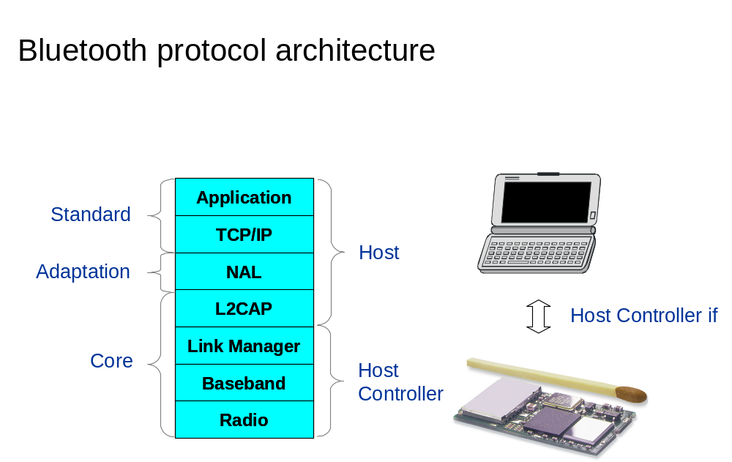
Protocol Architecture
ICS 243E - Ch 5 Wireless Lans
Winter 2001
5.<number>

Slide 39
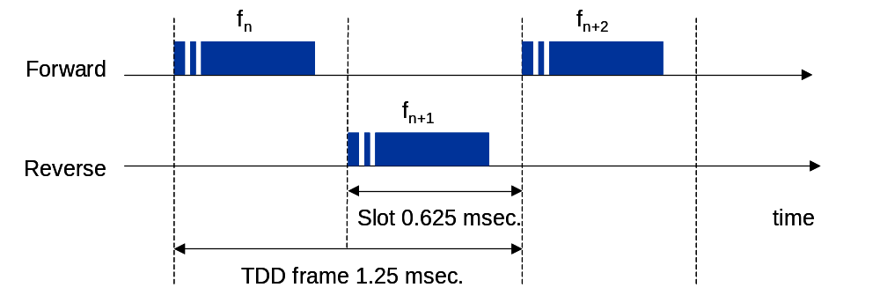
Baseband
2.4 GHz, FHSS (CDMA), TDD
ICS 243E - Ch 5 Wireless Lans
Winter 2001
5.<number>

Slide 40
FHSS Pattern: Synchronization
The slaves synchronize themselves to the Master Clock
Slave
Slave
Master
Slave
Slave
Piconet
ICS 243E - Ch 5 Wireless Lans
Winter 2001
5.<number>

Slide 41
Frequencsy Selection
Native clock (slave)
Phase
Hop frequency
+
Offset (master)
Bleutooth address (master)
ICS 243E - Ch 5 Wireless Lans
Winter 2001
5.<number>

Slide 42
Piconets and Scatternets
S1
S4
S5
S7
M1
S3
M2
S2
S6
Piconet A
Piconet B
Scatternet
ICS 243E - Ch 5 Wireless Lans
Winter 2001
5.<number>

Slide 43
FHSS
78
Frequency
0
Time
ICS 243E - Ch 5 Wireless Lans
Winter 2001
5.<number>

Slide 44
Interference
Sources:
  Other equipment in ISM band e.g. WLAN, micro-wave oven, etc.
  Frequency hopping
Remedies:
  Frequency hopping
  Short range
  Power control
  FEC and ARQN
  Short packets and fast acknowledgements
ICS 243E - Ch 5 Wireless Lans
Winter 2001
5.<number>

Slide 45
Error Control
1/3 rate Forward Error Correction (FEC)
2/3 rate Forward Error Correction (FEC)
Automatic Repeat reQuest (ARQ)
ICS 243E - Ch 5 Wireless Lans
Winter 2001
5.<number>

Slide 46
Link Types
Synchronous Connection Oriented (SCO)
  Circuit switched typically used for voice
  Symmetric, synchronous service
  Slot reservation at fixed intervals
  Point-to-point
Asynchronous Connectionless Link (ACL)
  Packet switched
  Symmetric or asymmetric, asynchronous service
  Polling mechanism between master and slave(s)
  Point-to-point and point-to-multipoint
ICS 243E - Ch 5 Wireless Lans
Winter 2001
5.<number>

Slide 47
Flexibility: Multislot Packets
No frequency hopping during multislots, sequence continues after transmission
f_{n} f_{n+1} f_{n+2} f_{n+3} f_{n+4} f_{n+5}
Single slot
f_{n} f_{n+3}
Three slot
f_{n} f_{n+5}
Five slot
ICS 243E - Ch 5 Wireless Lans
Winter 2001
5.<number>

Slide 48
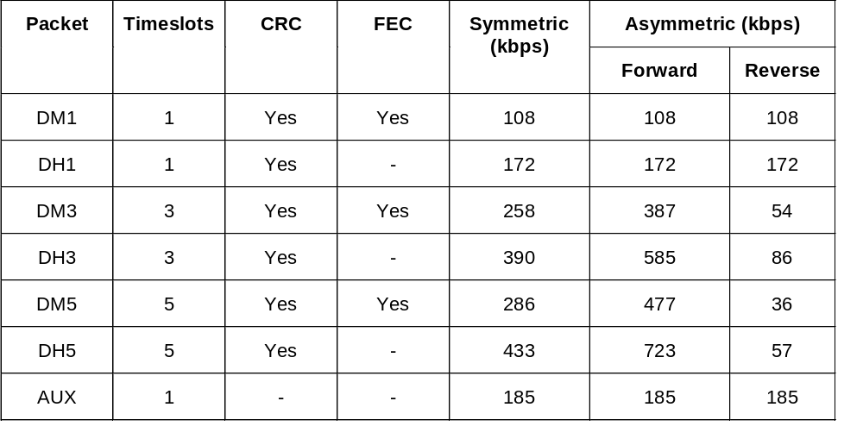
ACL data rates
ICS 243E - Ch 5 Wireless Lans
Winter 2001
5.<number>

Slide 49
ACL Polling Scheme:
Master
ICS 243E - Ch 5 Wireless Lans
Winter 2001
5.<number>

Slide 50
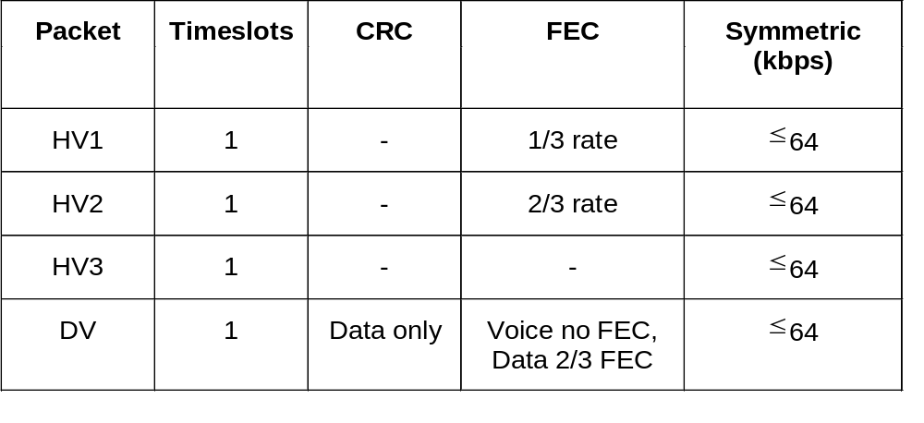
SCO data rates
ICS 243E - Ch 5 Wireless Lans
Winter 2001
5.<number>

Slide 51
Voice and Data Transmission:
SCO
ACL
ACL
SCO
ACL
ACL
SCO
ACL
Master
Slave
Slave
Slave
ICS 243E - Ch 5 Wireless Lans
Winter 2001
5.<number>

Slide 52
Capacity of Piconet
One ACL link (432 kbps symmetric or 721/56 kbps asymetric)
or
Three simultaneous SCO links (64 kbps)
or
A combination of voice/data
S1
S4
M1
S3
S2
ICS 243E - Ch 5 Wireless Lans
Winter 2001
5.<number>

Slide 53
States of a Bluetooth device (PHY layer)
STANDBY
unconnected
inquiry
page
connecting
transmit
connected
active
PARK
HOLD
SNIFF
low power
ICS 243E - Ch 5 Wireless Lans
Winter 2001
5.<number>

Slide 54
Bluetooth MAC layer
Synchronous Connection-Oriented link (SCO)
  symmetrical, circuit switched, point-to-point
Asynchronous Connectionless Link (ACL)
  packet switched, point-to-multipoint, master polls
Access code
  synchronization, derived from master, unique per channel
Packet header
  1/3-FEC, MAC address (1 master, 7 slaves), link type, alternating bit ARQ/SEQ, checksum
72
54
0-2745
bits
access code
packet header
payload
3
4
1
1
1
8
bits
MAC address
type
flow
ARQN
SEQN
HEC
ICS 243E - Ch 5 Wireless Lans
Winter 2001
5.<number>

Slide 55
Error Control Details
Packet header:
  1/3 rate FEC
SCO payload:
  1/3 rate FEC
  2/3 FEC
  no FEC
ACL payload:
  ARQN using payload CRC (except AUX packet)
  2/3 rate FEC optional
ICS 243E - Ch 5 Wireless Lans
Winter 2001
5.<number>

Slide 56
Connection Set up in an existing Piconet
Master
Resp.
Resp.
data.
FHS
data
Page
Page
Slave
ICS 243E - Ch 5 Wireless Lans
Winter 2001
5.<number>

Slide 57
Scatternets
Each piconet has one master and up to 7 slaves
Master determines hopping sequence, slaves have to synchronize
Participation in a piconet = synchronization to hopping sequence
Communication between piconets = devices jumping back and forth between the piconets
piconets
ICS 243E - Ch 5 Wireless Lans
Winter 2001
5.<number>

Slide 58
Summary
Bluetooth:
  Wireless voice and data for mobile devices
IrDA:
  Wirelss data cable replacement for devices in line of sight
HomeRF:
  Networking mobile data and voice devices to a PC anywhere in the home
IEEE 802.11 and Hiperlan 2:
  Wireless enterprise networking in the office
ICS 243E - Ch 5 Wireless Lans
Winter 2001
5.<number>

Slide 59
Where Bluetooth fits in
Bluetooth
GSM
GPRS
Bandwidth
UMTS
DECT
WLAN
IrDA
WLAN
UMTS
IR
Bluetooth
GPRS
Dect
GSM
Coverage
ICS 243E - Ch 5 Wireless Lans
Winter 2001
5.<number>

Slide 60
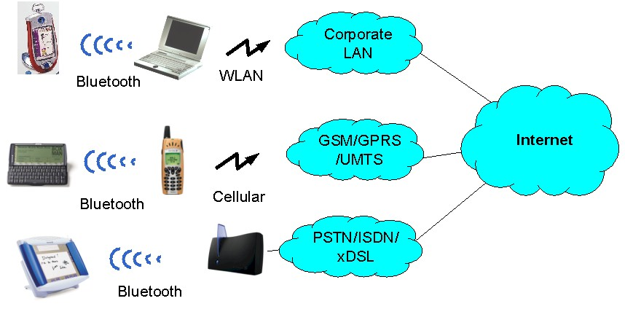
Bluetooth functionality
ICS 243E - Ch 5 Wireless Lans
Winter 2001
5.<number>

